Slide 1
HOW TO USE R&D PORTAL
STEP-1: REGISTARTION ON PORTAL
Enter the URL https://research.steel.gov.in/Applicant .
From Home Page Click on to Registration, steps are shown in the slide numbers 3-7.
After that, Users can login into the portal using their credentials.
STEP-2: Reset/Change/Forgot Password ON PORTAL
Users can Reset/Change/retrieve their password as per slide Number 8.

Slide 2
HOW TO USE R&D PORTAL (Contd…)
STEP-3: UPLOADING OF PROJECT PROPOSAL ON PORTAL
For Logging into the R&D Portal refer slide 9.
User’s home screen will be as shown in slide 10.
For complete guidance, please refer slides 11-18 regarding filling of R&D proposal.
Please refer the Annexure-3, of R&D Scheme Highlights, Guidelines & Terms & Conditions document available at home page of the portal & also at Ministry of Steel’s website.
STEP-4: UPLOADING OF STATUS OF OLD PROJECTS ON PORTAL
User/PI (after registration) of already running projects under the R&D Scheme of Ministry of Steel has to submit the ‘Quarterly Project Status Report’ of their R&D project(s) as per Annexure-4, of R&D Scheme Highlights, Guidelines & Terms & Conditions.
For complete guidance, please refer slides 19-29.

Slide 3
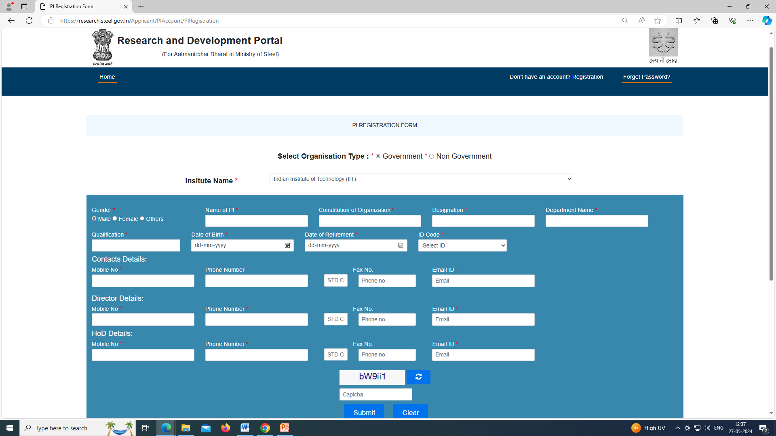
Select the Organisation Type & Institute Name.
If Institute is not available in the drop-down list, please write to us at : tech-steel@nic.in
Fill the below details carefully.
Fill the details of PI/Applicant

Slide 4
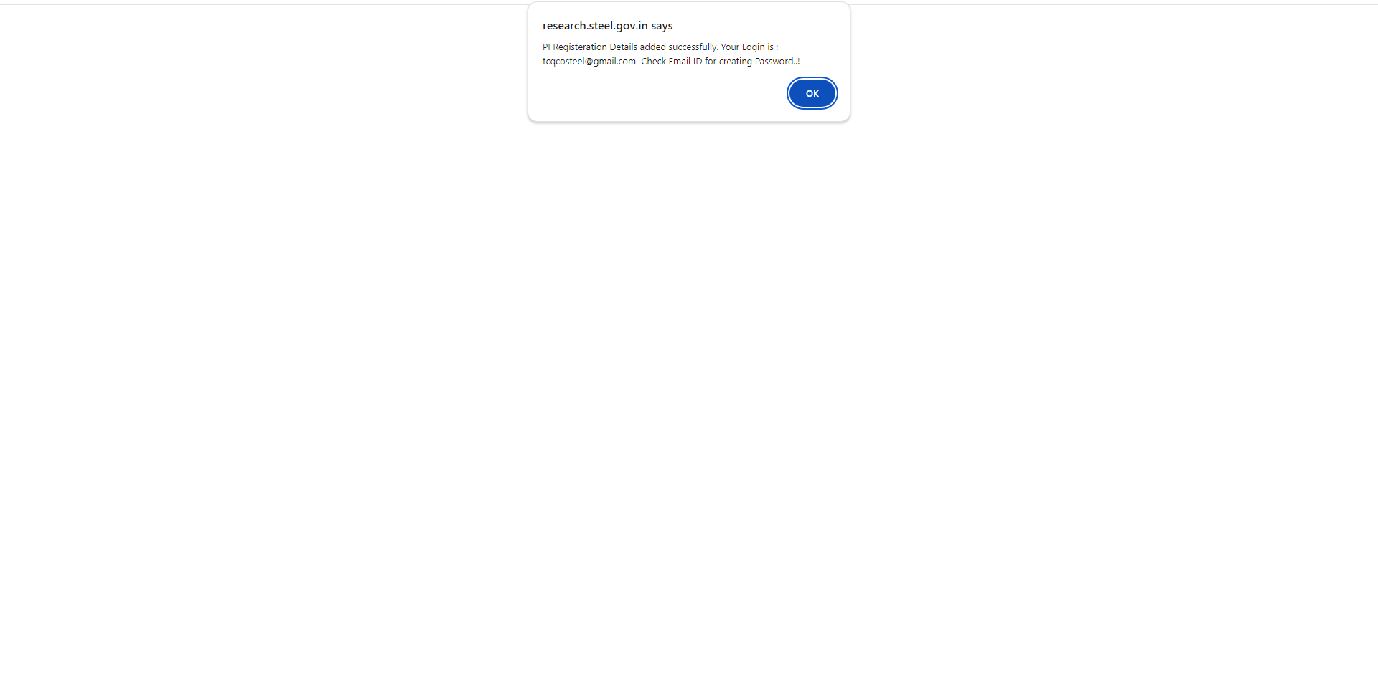
Refer previous slide, after ‘Submit’ User will get the below message.

Slide 5
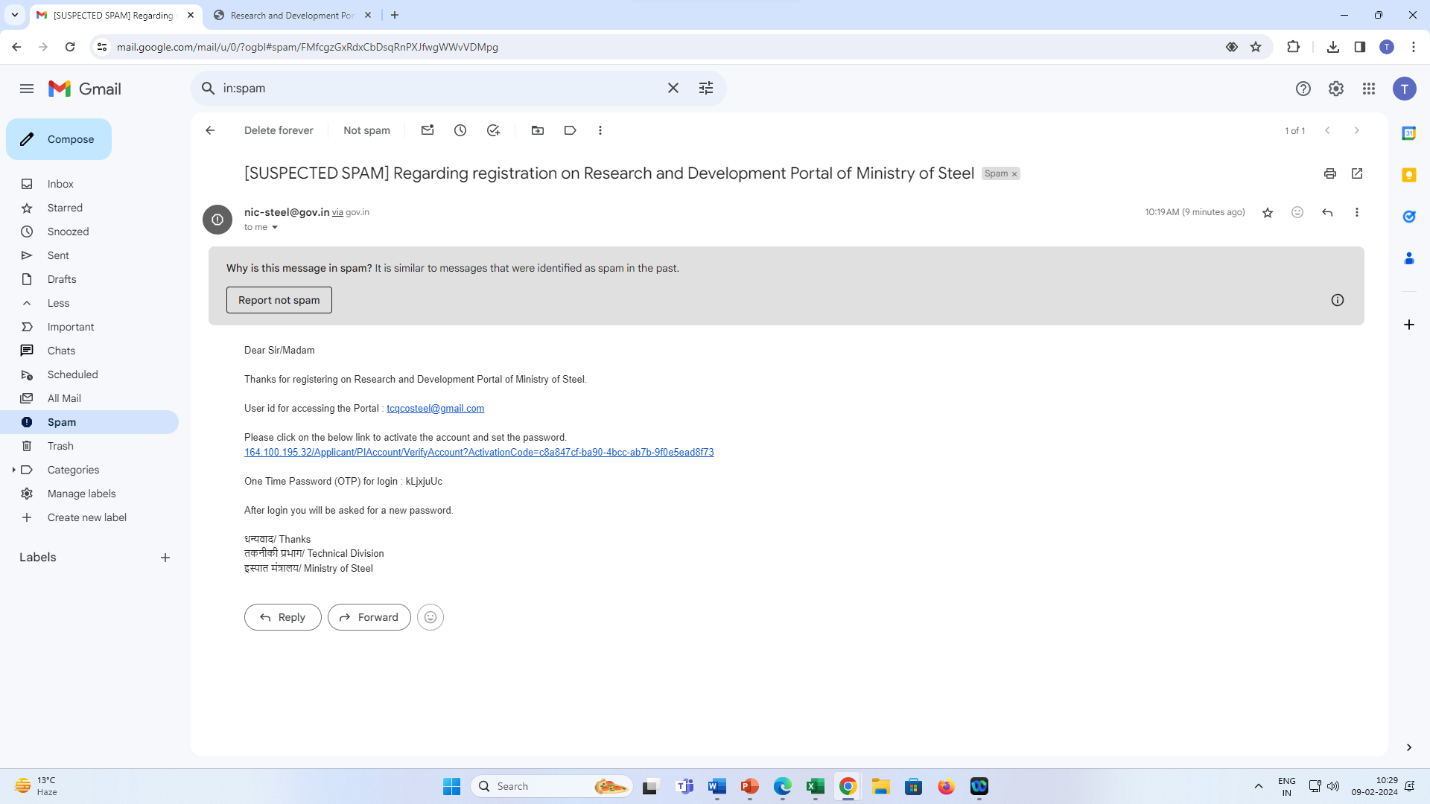
Refer previous slide, after ‘Ok’ , User will get an email as shown below.

Slide 6
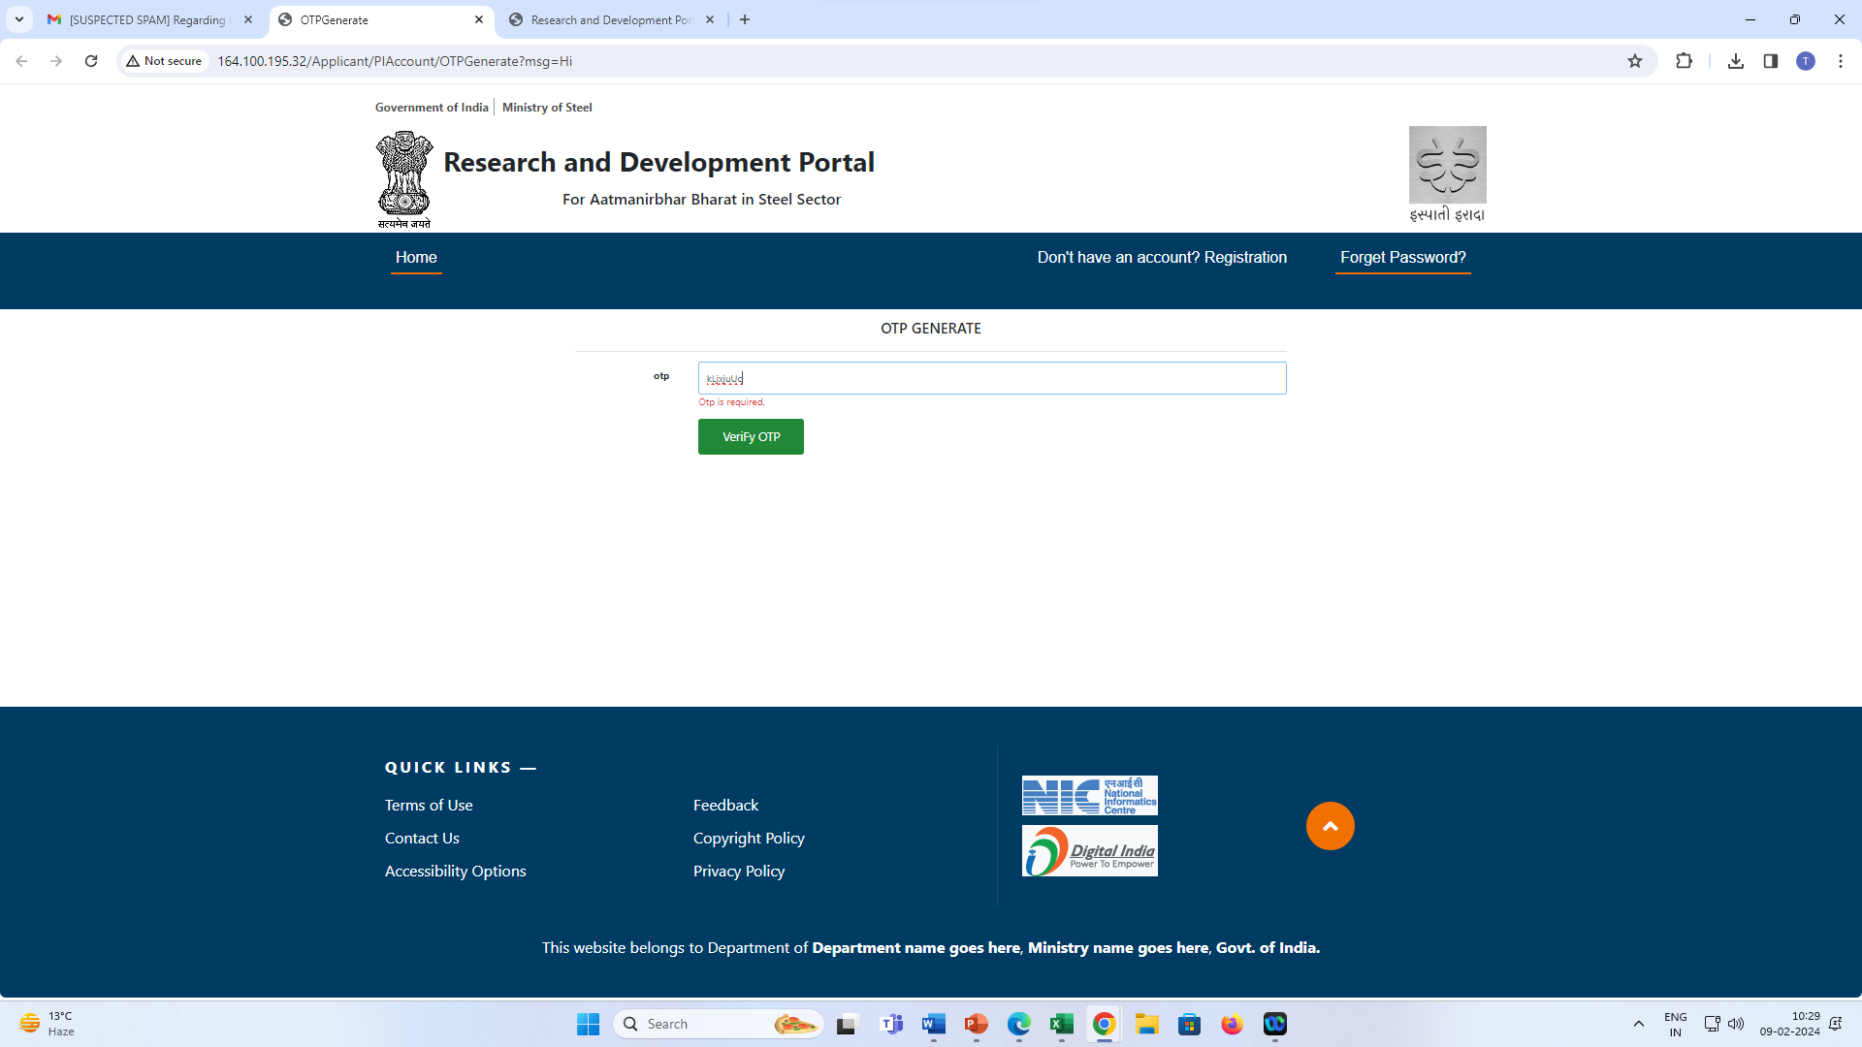
User will have to click on the activation link given in the email (previous slide) & verify with the OTP provided in the said email.

Slide 7
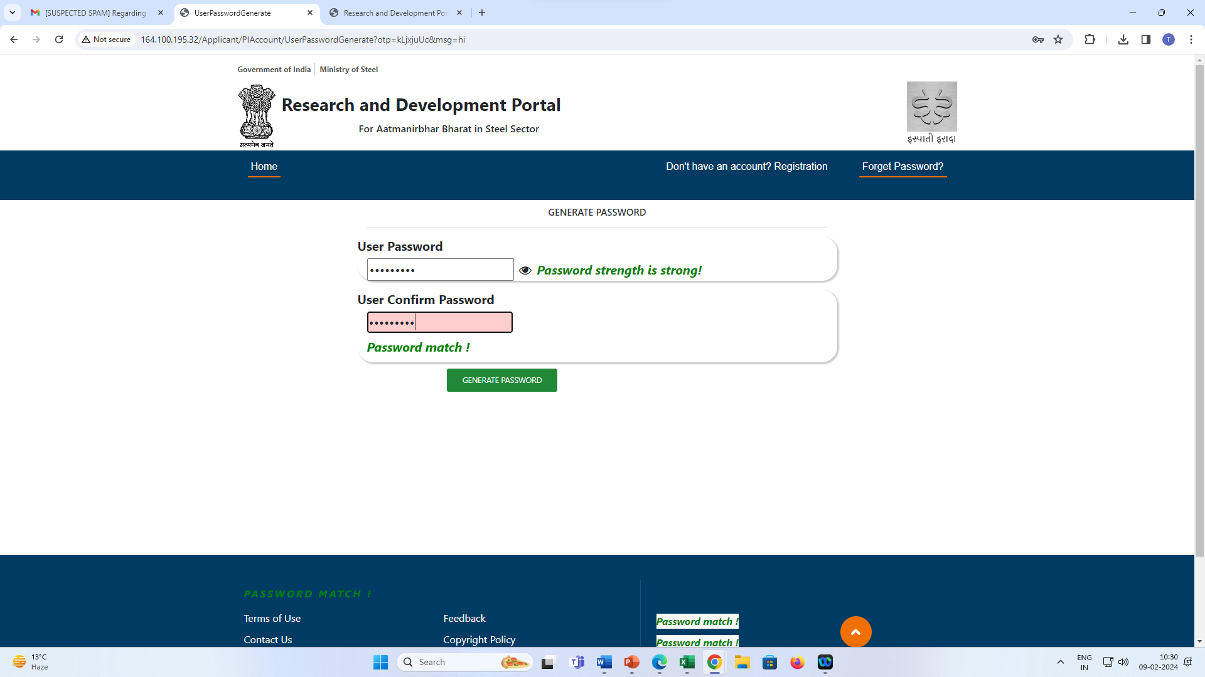
After ‘OTP Verification’, user has to set the password.

Slide 8
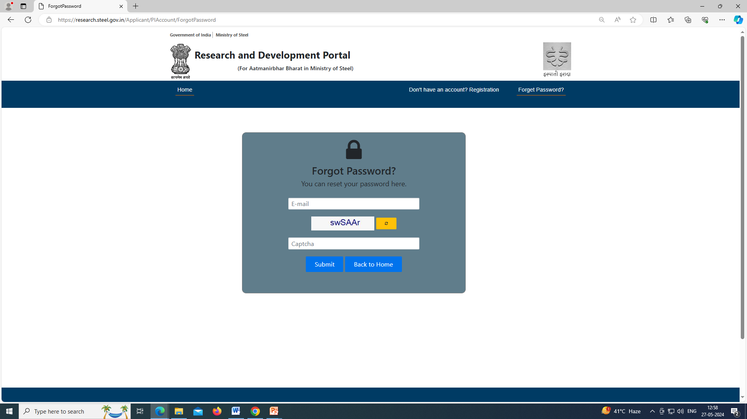
Please enter the details & press submit button.
After this, user will receive an email for password reset.

Slide 9
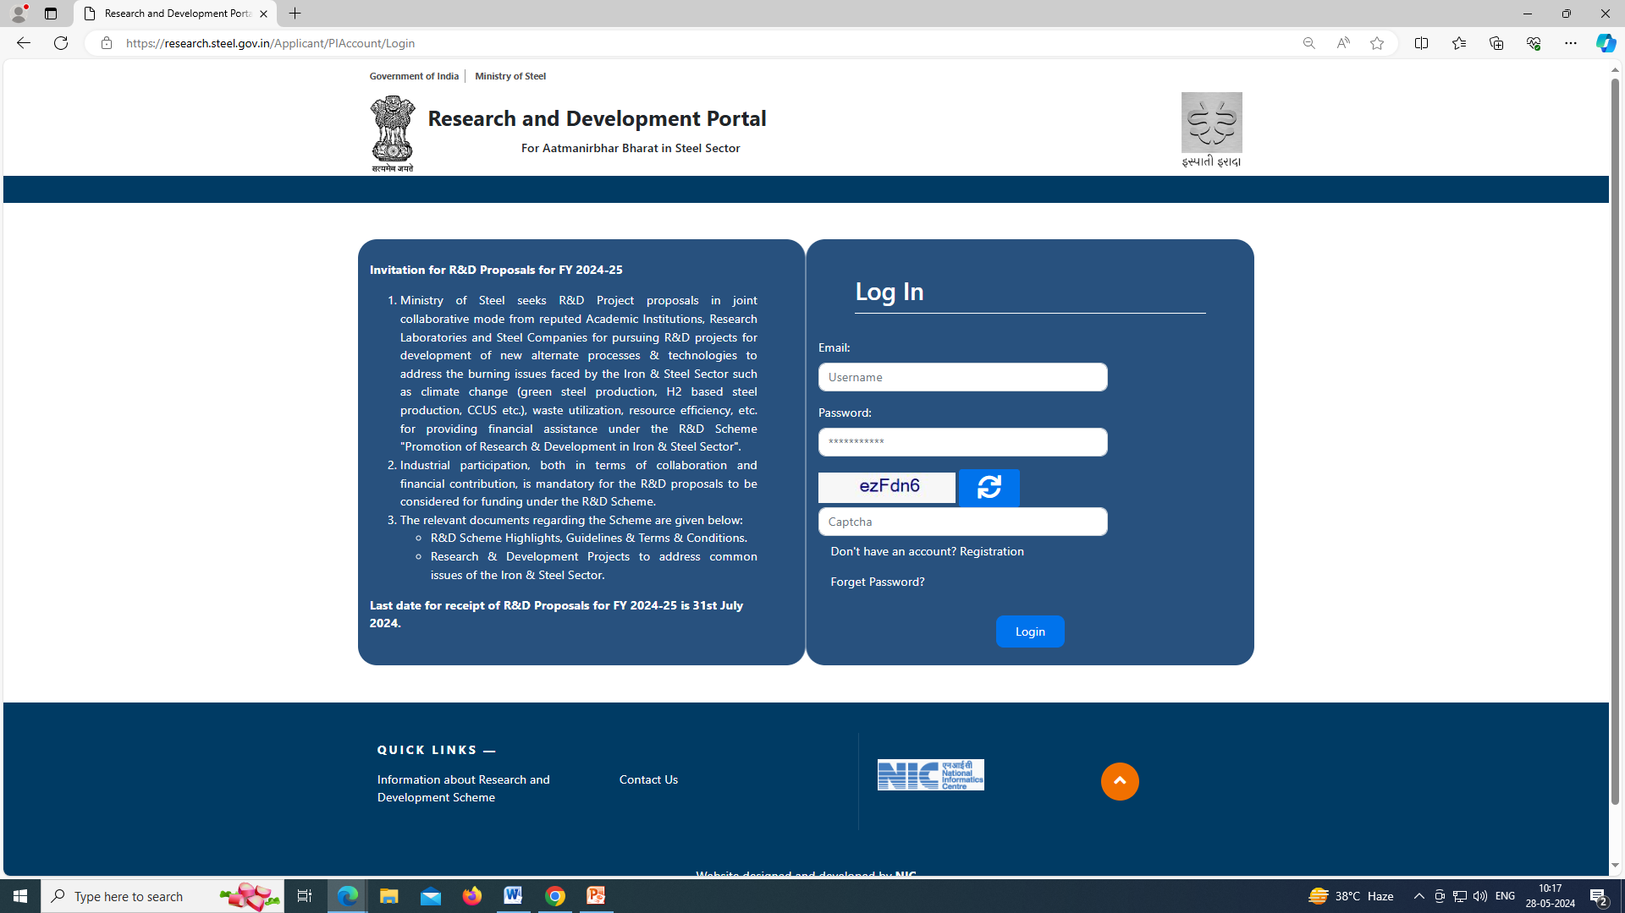
Landing Page of R&D Portal
User will enter the registered email id & password for logging in into the portal.

Slide 10
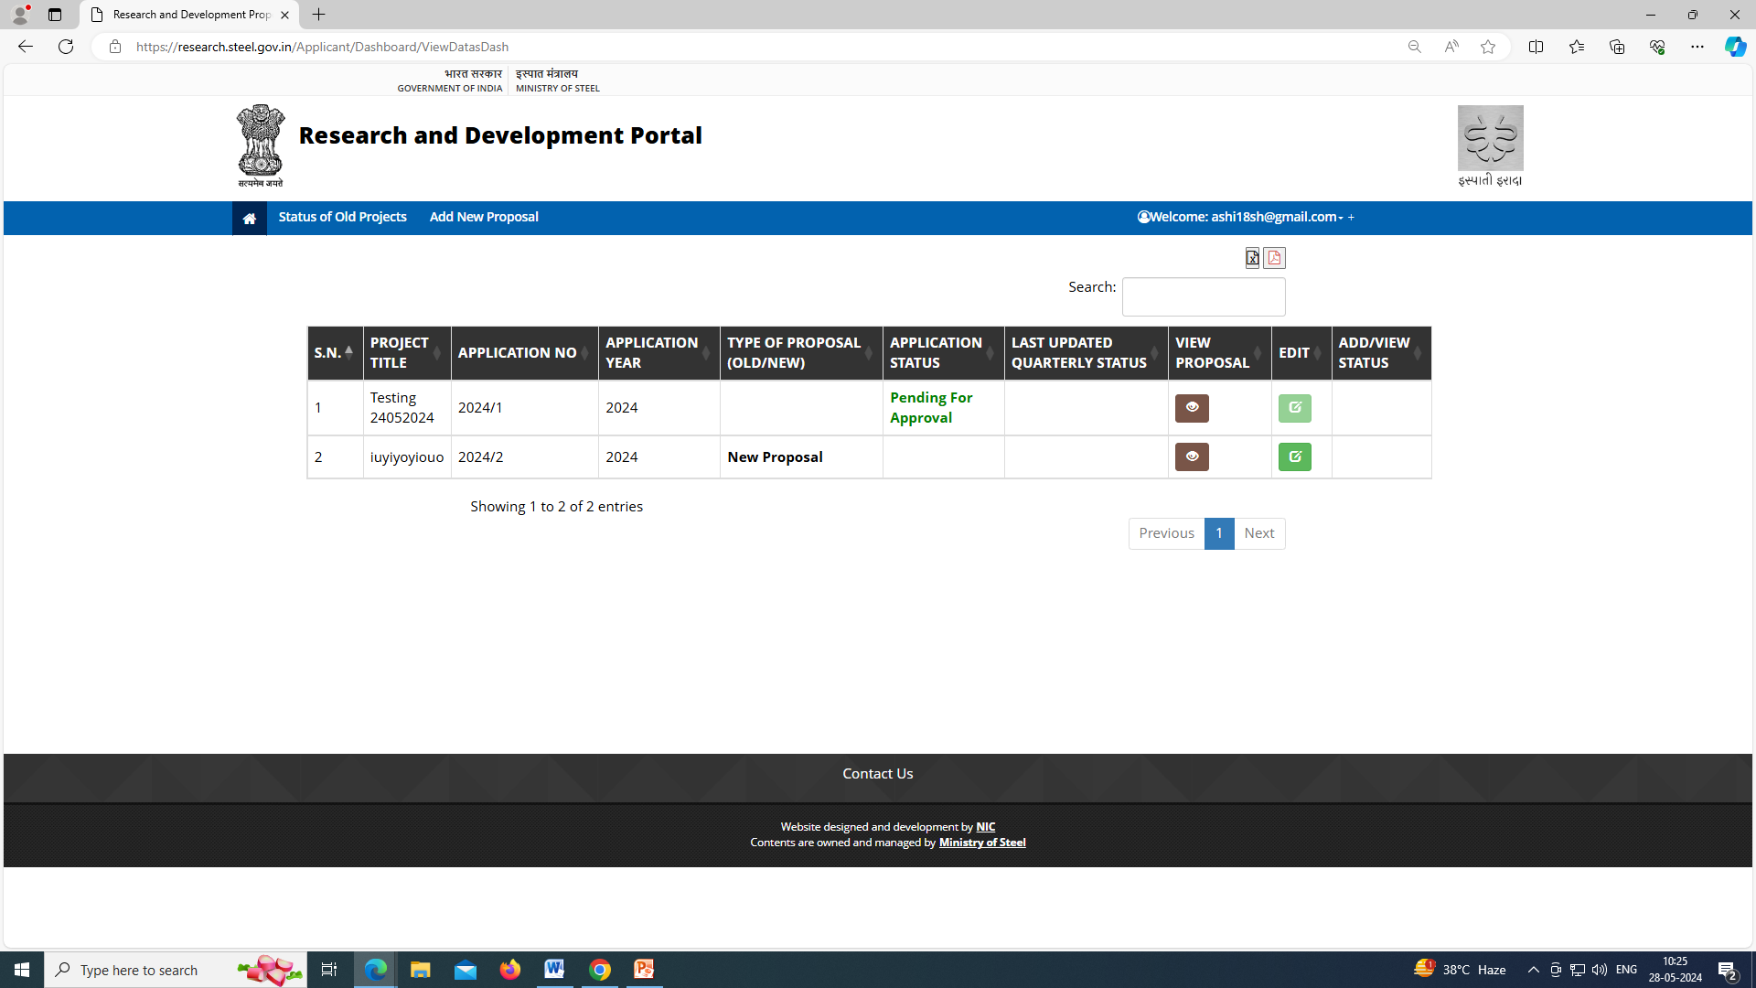
Click on ‘Add New Proposal’ to submit R&D Proposal
Click on ‘Status of Old Project’ to submit Quarterly Project Status Report of the R&D project.
User’s Home screen

Slide 11
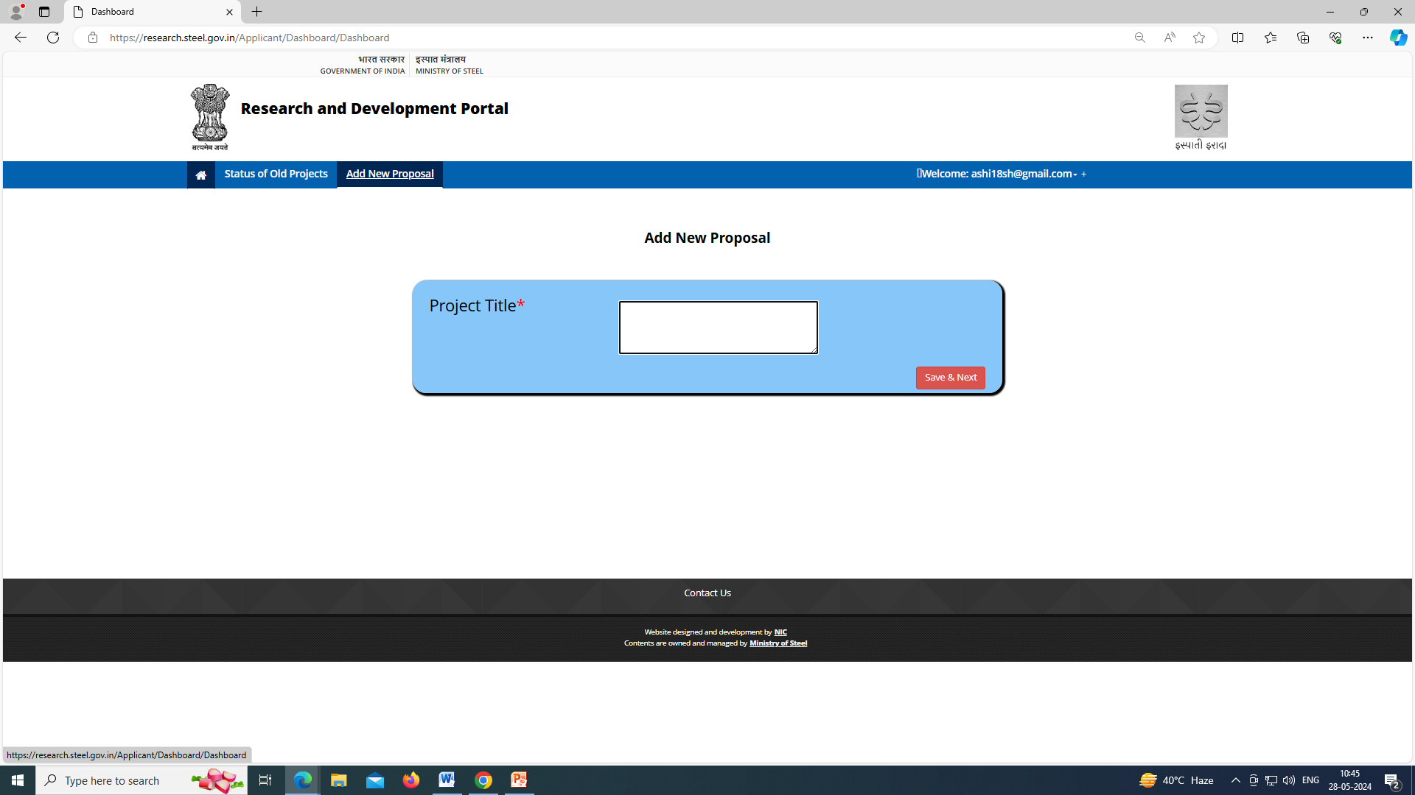
Please fill the proposal in line with Annexure-3 of R&D Scheme Highlights, Guidelines & Terms & Conditions document available at home page of the portal.

Slide 12
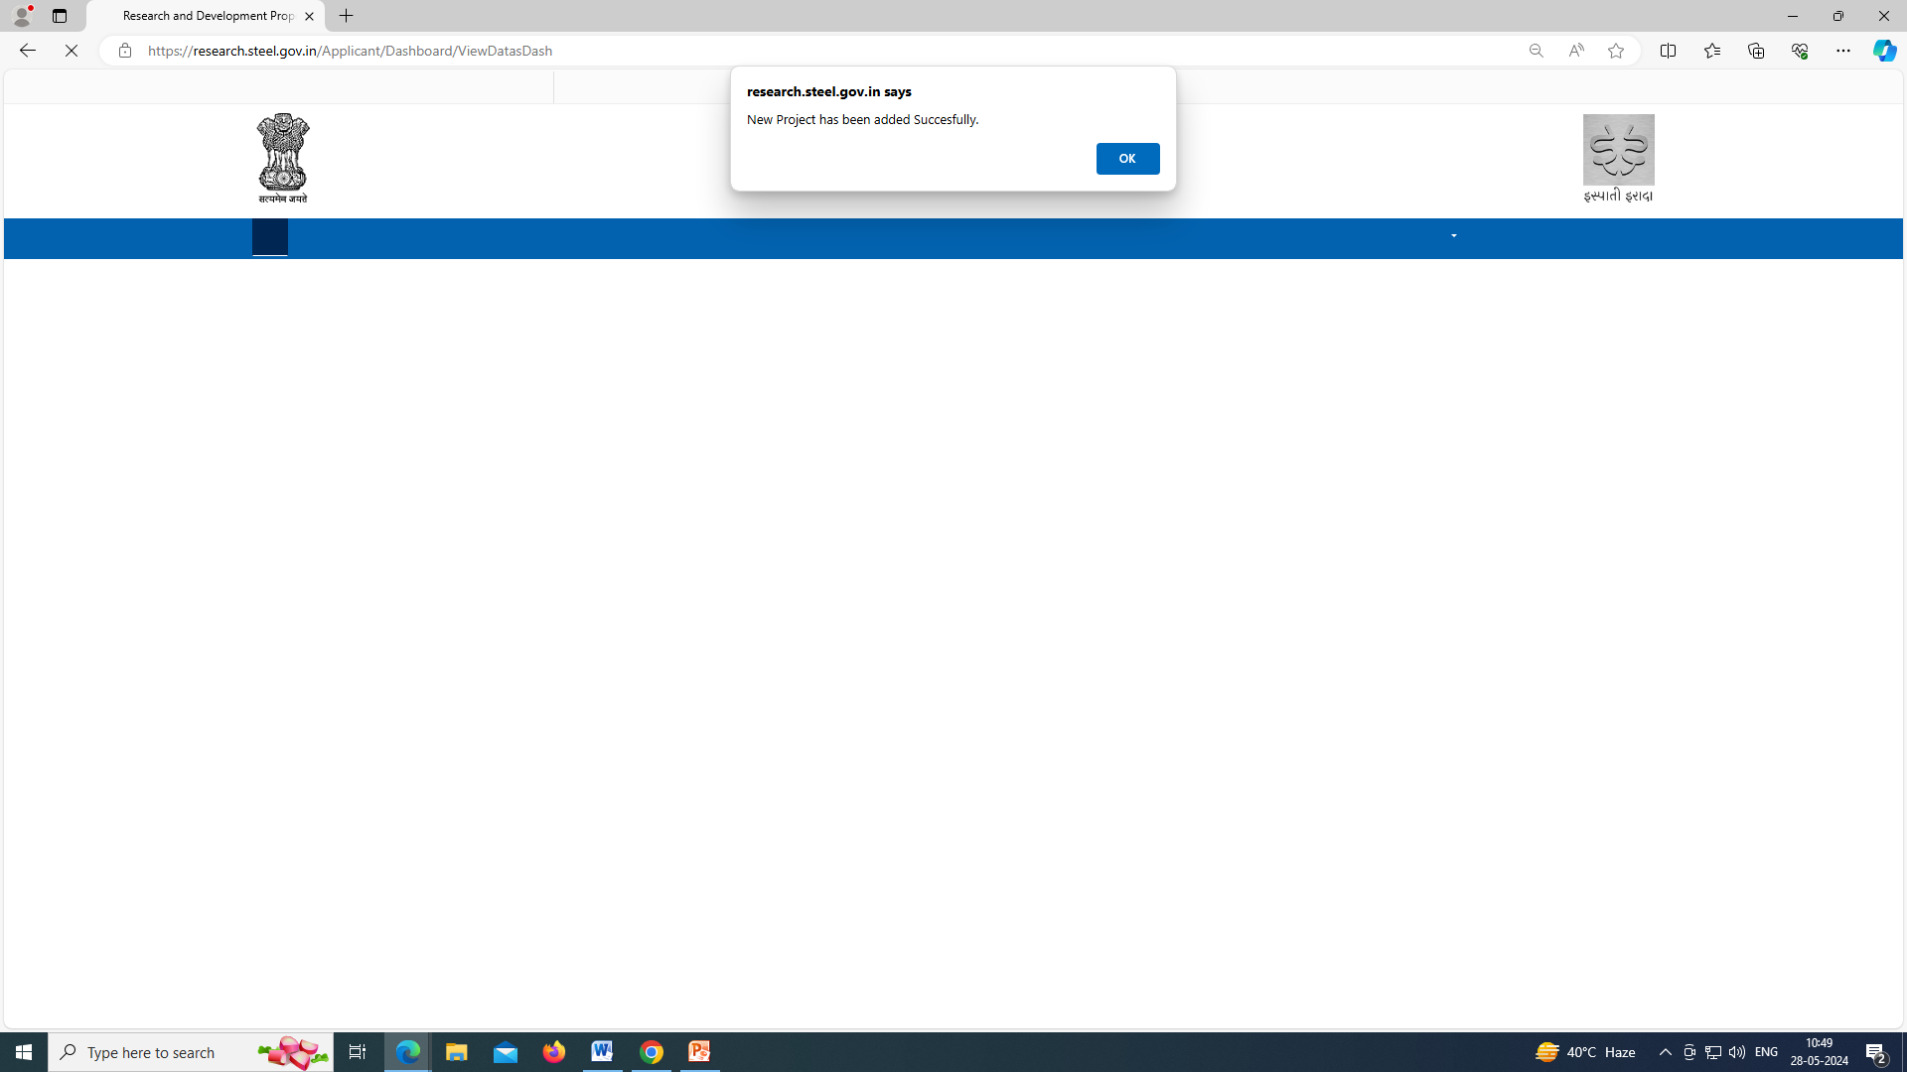
Refer previous slide, this page will appear after entering ‘Project Title’ & clicking on ‘Save & Next’.

Slide 13
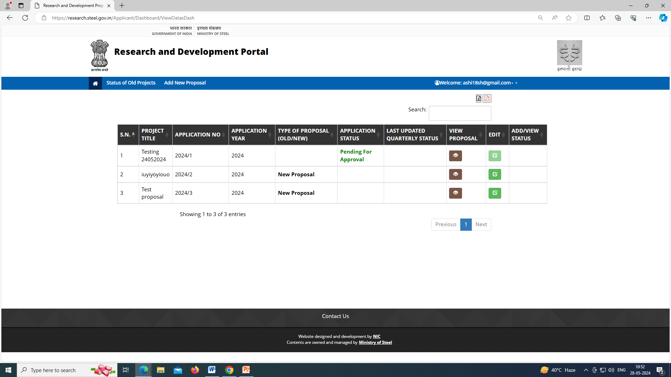
New Project added.
To fill the complete details of proposal, User will click on ‘Edit’ button and new page will open (Refer next slide).

Slide 14
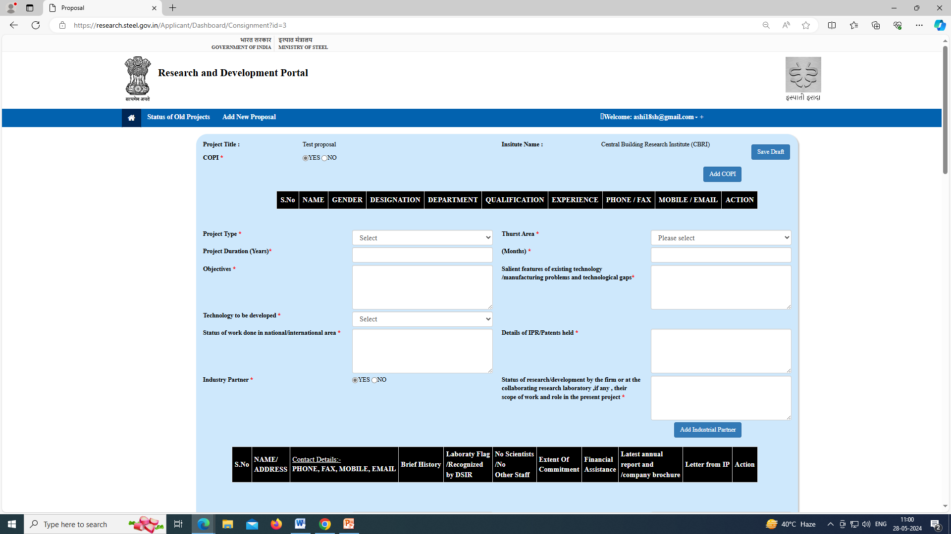
Please refer Annexure-3 of R&D Scheme Highlights, Guidelines & Terms & Conditions document available at home page of the portal.
User can add ‘COPI & Industrial Partner’ via clicking on the relevant tabs.

Slide 15
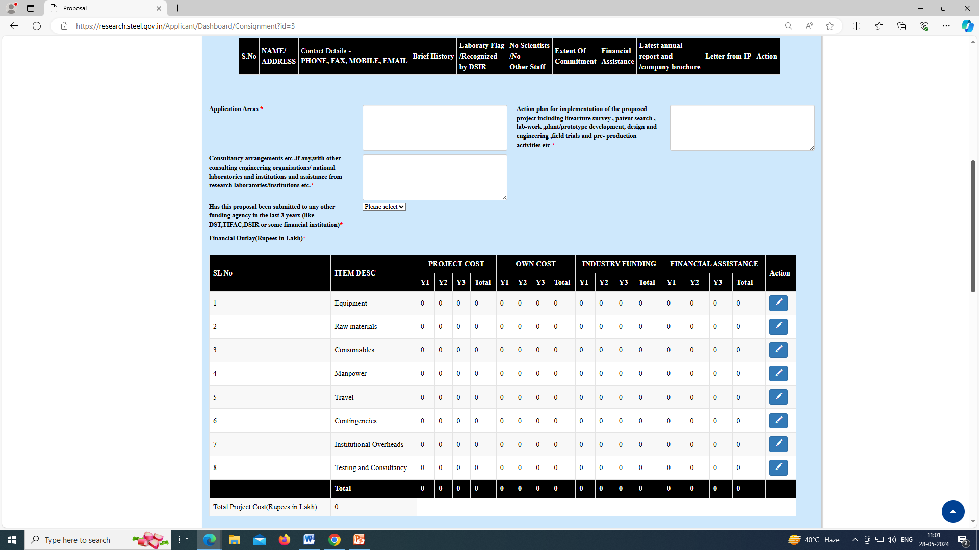

Slide 16
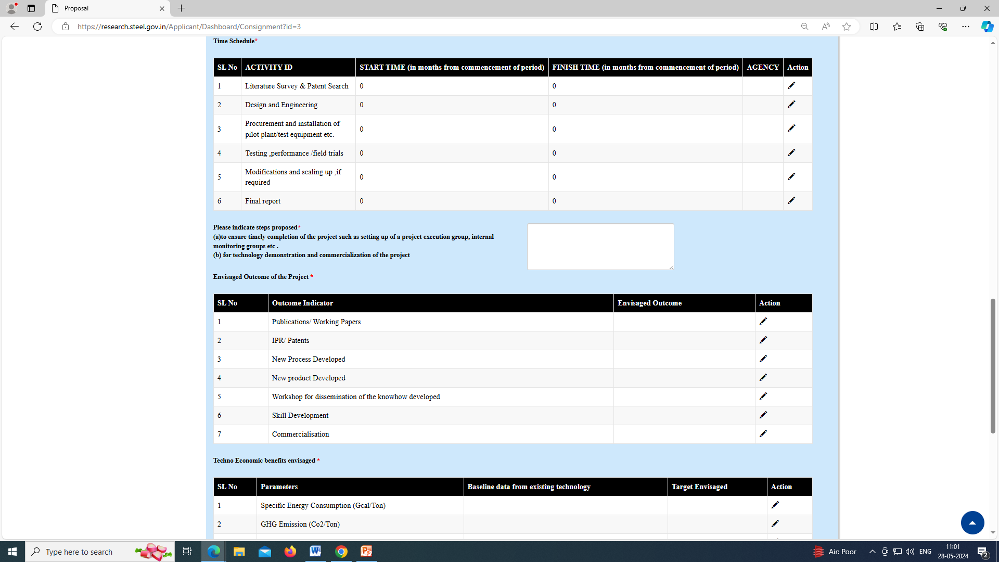

Slide 17
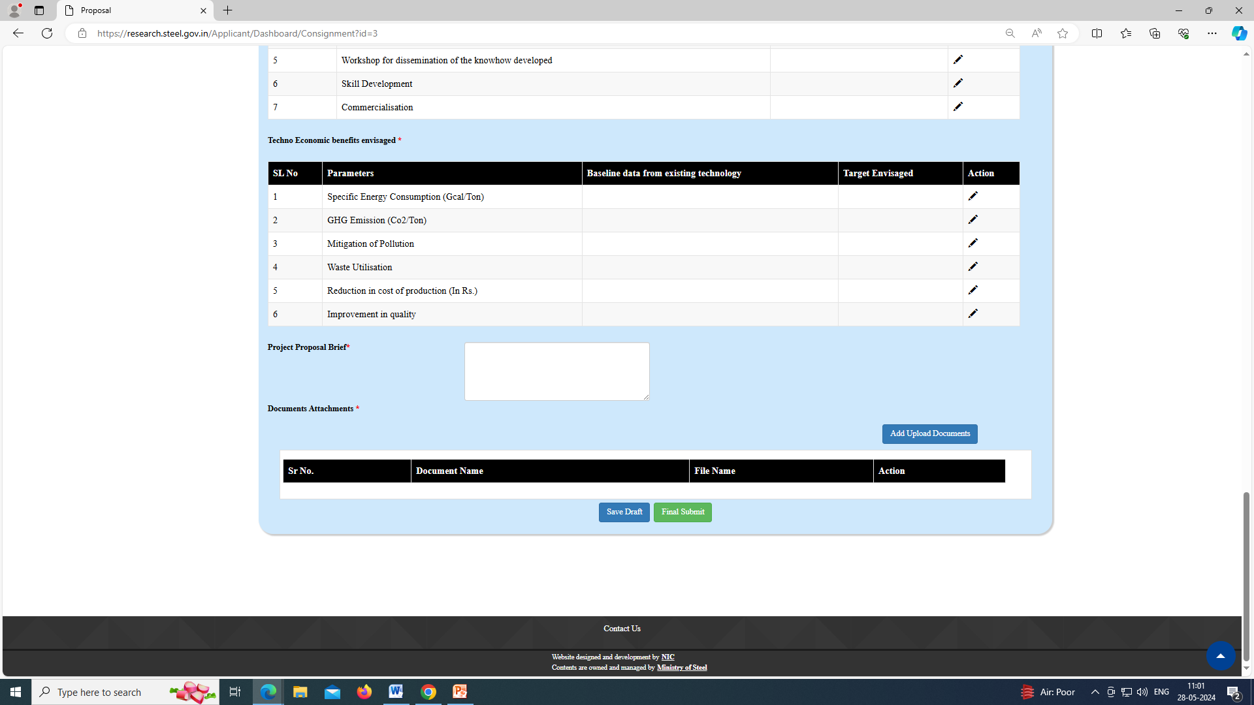
For document uploading user will click on ‘Add Upload Document’ button.

Slide 18
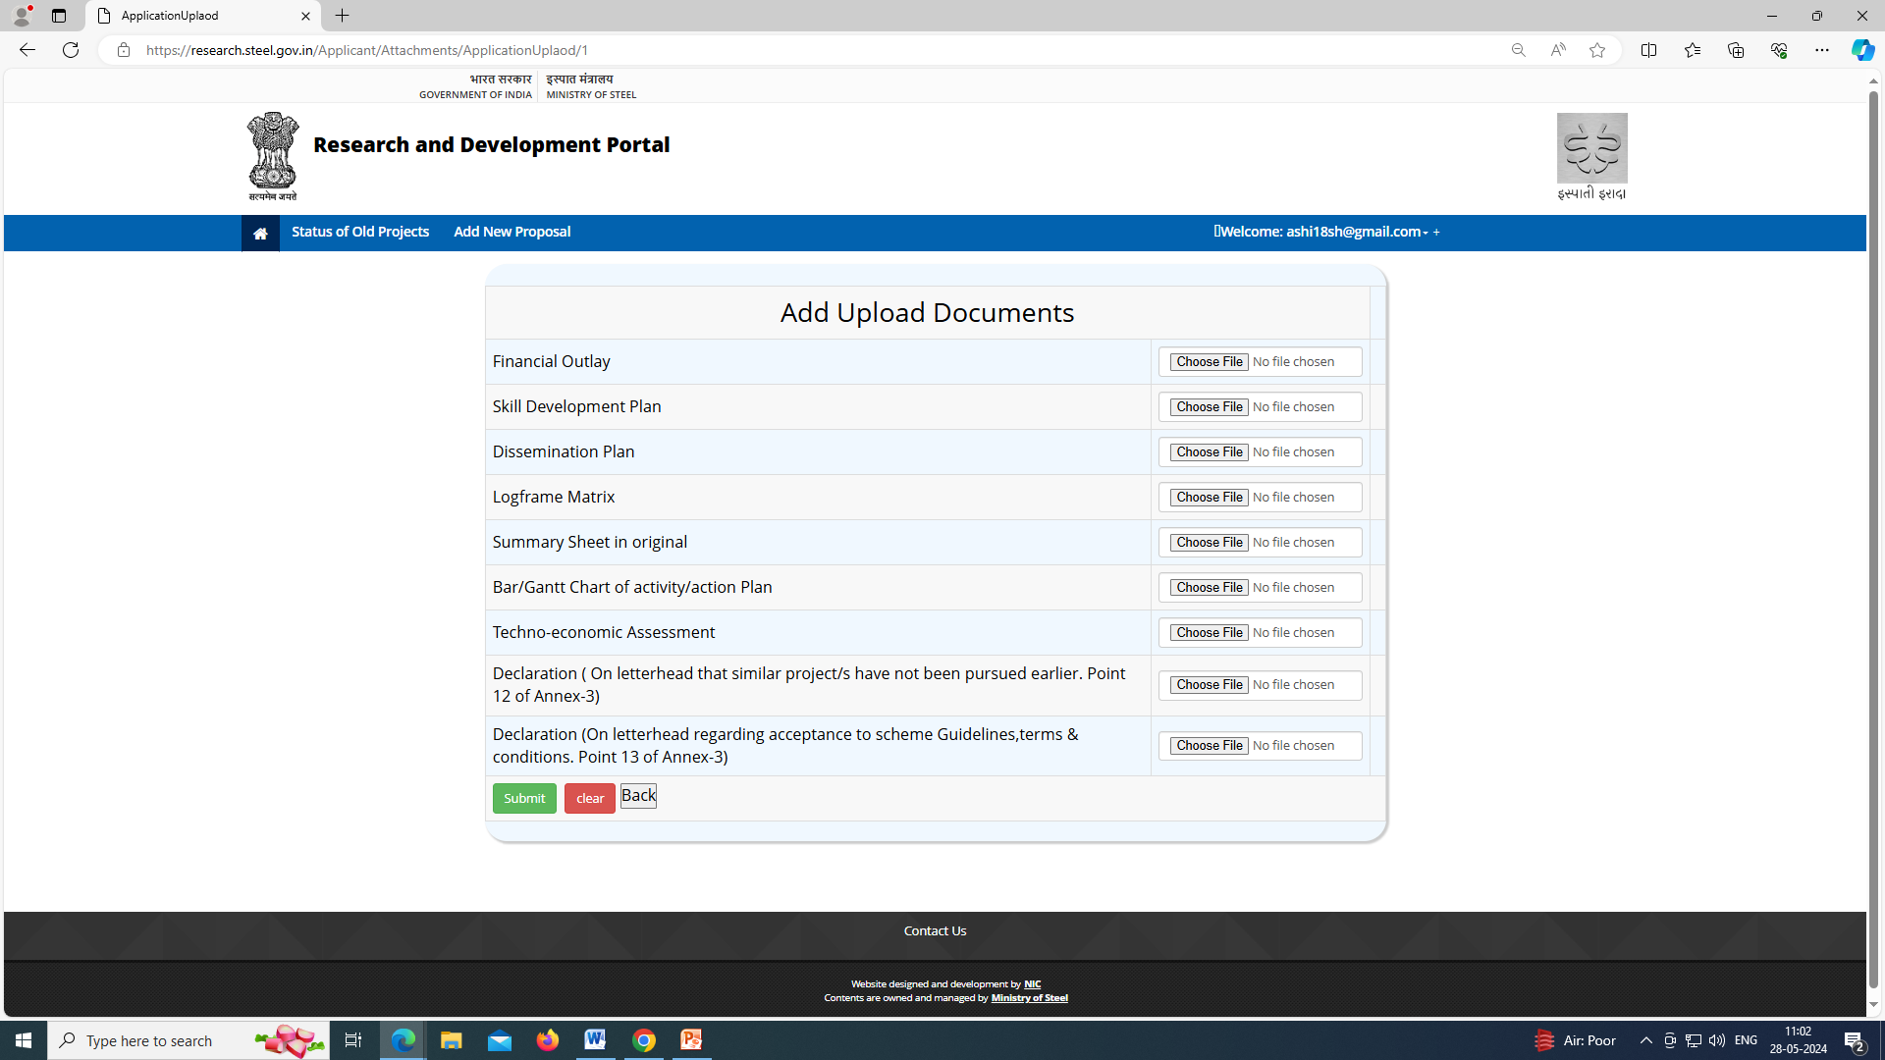
Upload the pdf files of documents.

Slide 19
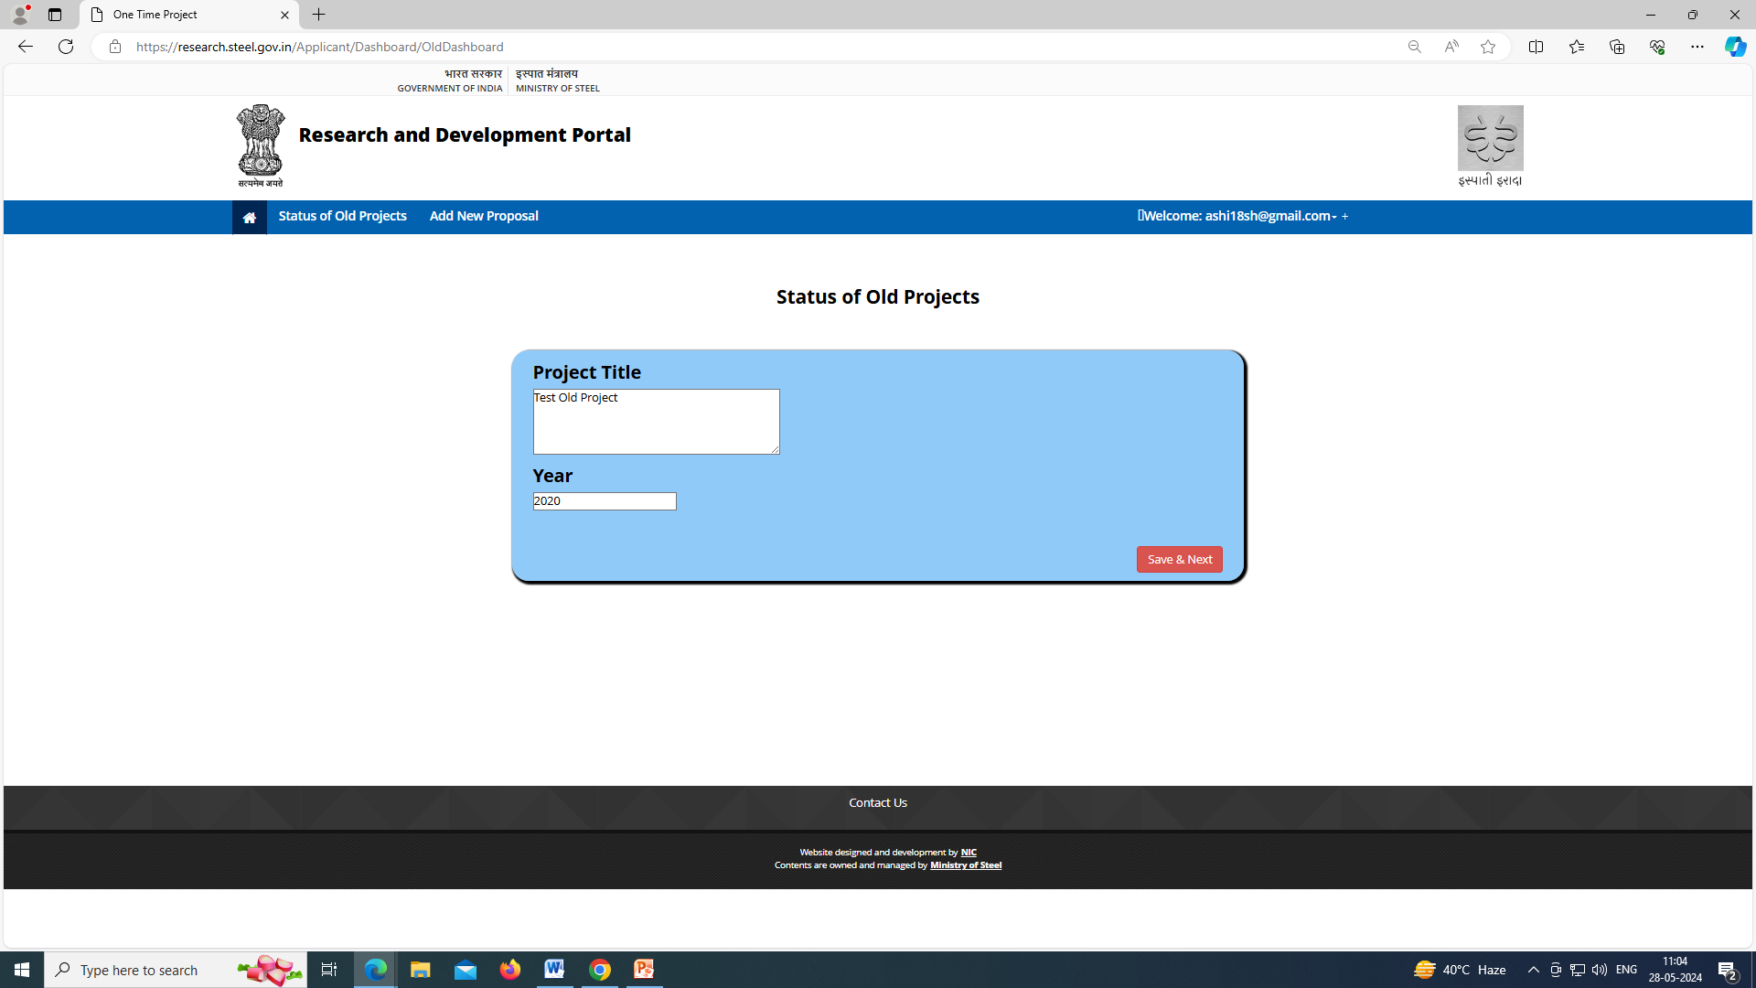
User will click on ‘Status of Old Project’ tab, the same page will open.
User can submit “Quarterly Project Status Report” of the R&D project as per Annexure-4 of R&D Scheme Highlights, Guidelines & Terms & Conditions document available at home page of the portal.

Slide 20
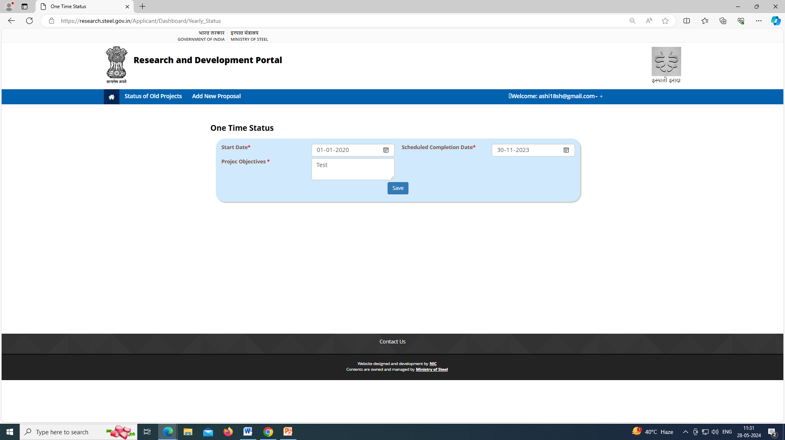
This page will open after ‘Save&Next’ operation of previous slide.

Slide 21
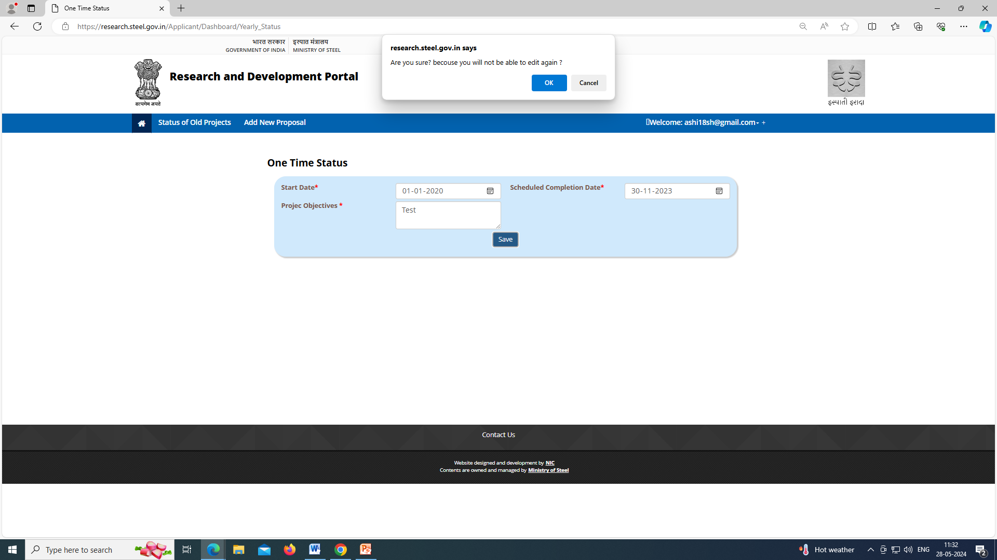
After clicking on ‘Save’ button, a message will be displayed (as shown at the top)

Slide 22
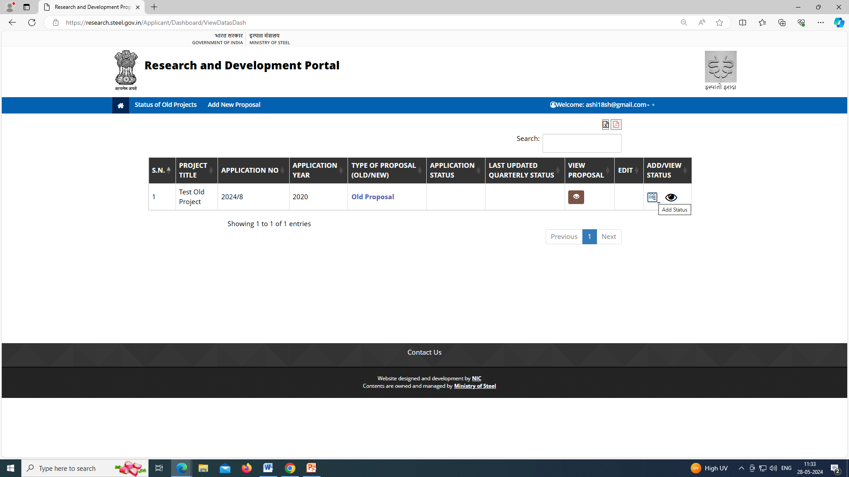
Refer previous slide, after ‘Save’, the entry will be available at user’s home page (as shown above).
Now, users will click on ‘Add_Status’ icon and fill the complete status report.

Slide 23
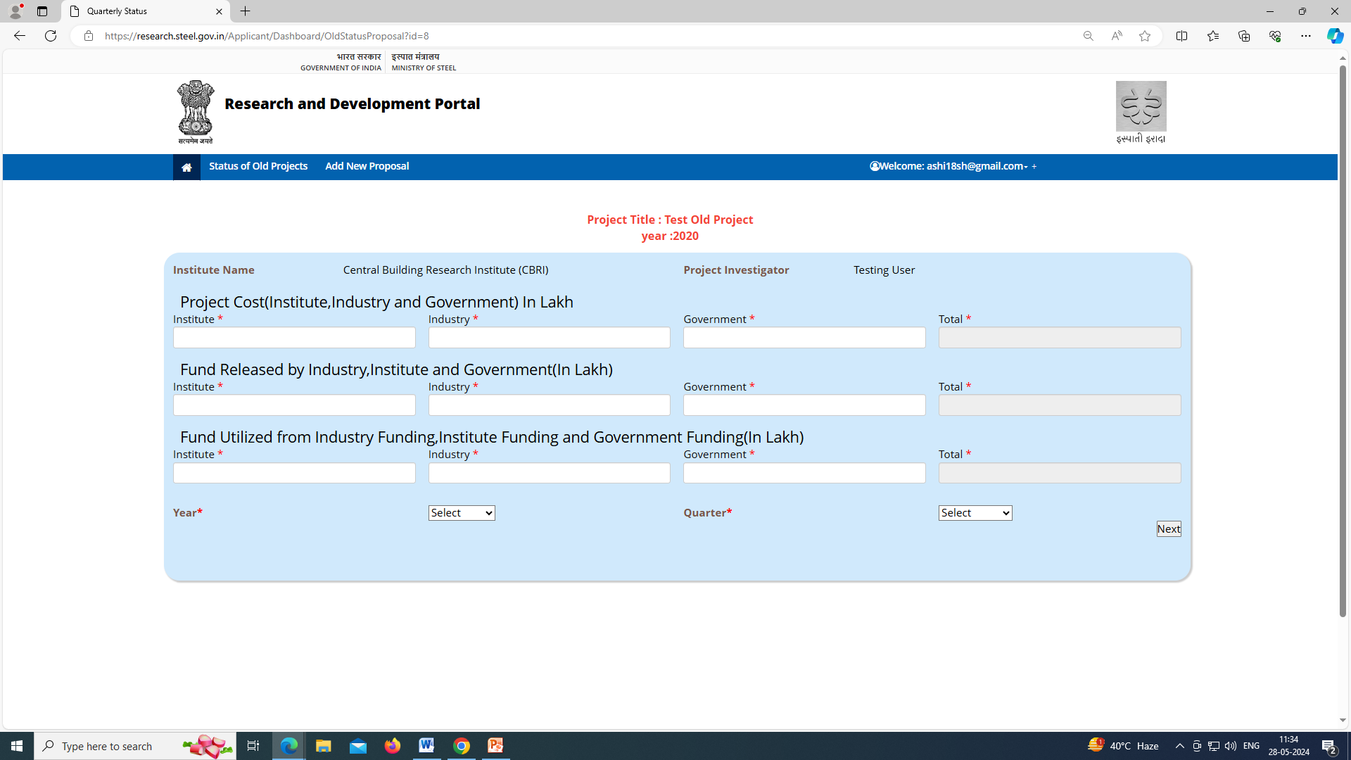
After click on ‘Add_Status’ icon, this page will open. Fill the details and submit it (Refer next three slides for complete operation).

Slide 24
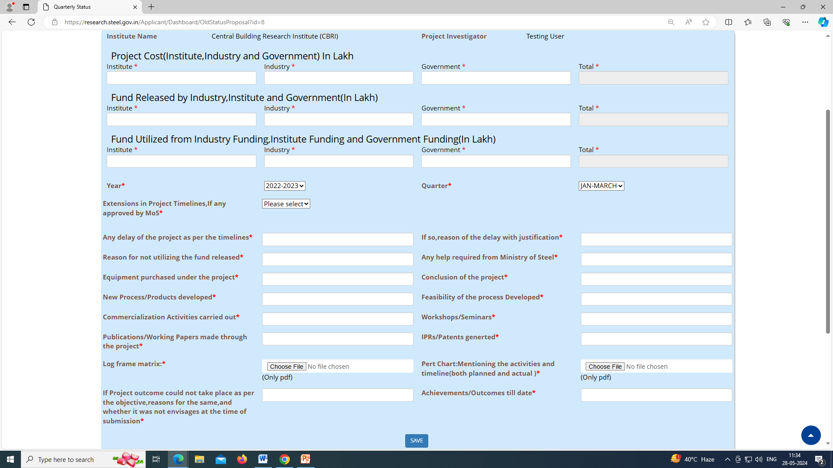

Slide 25
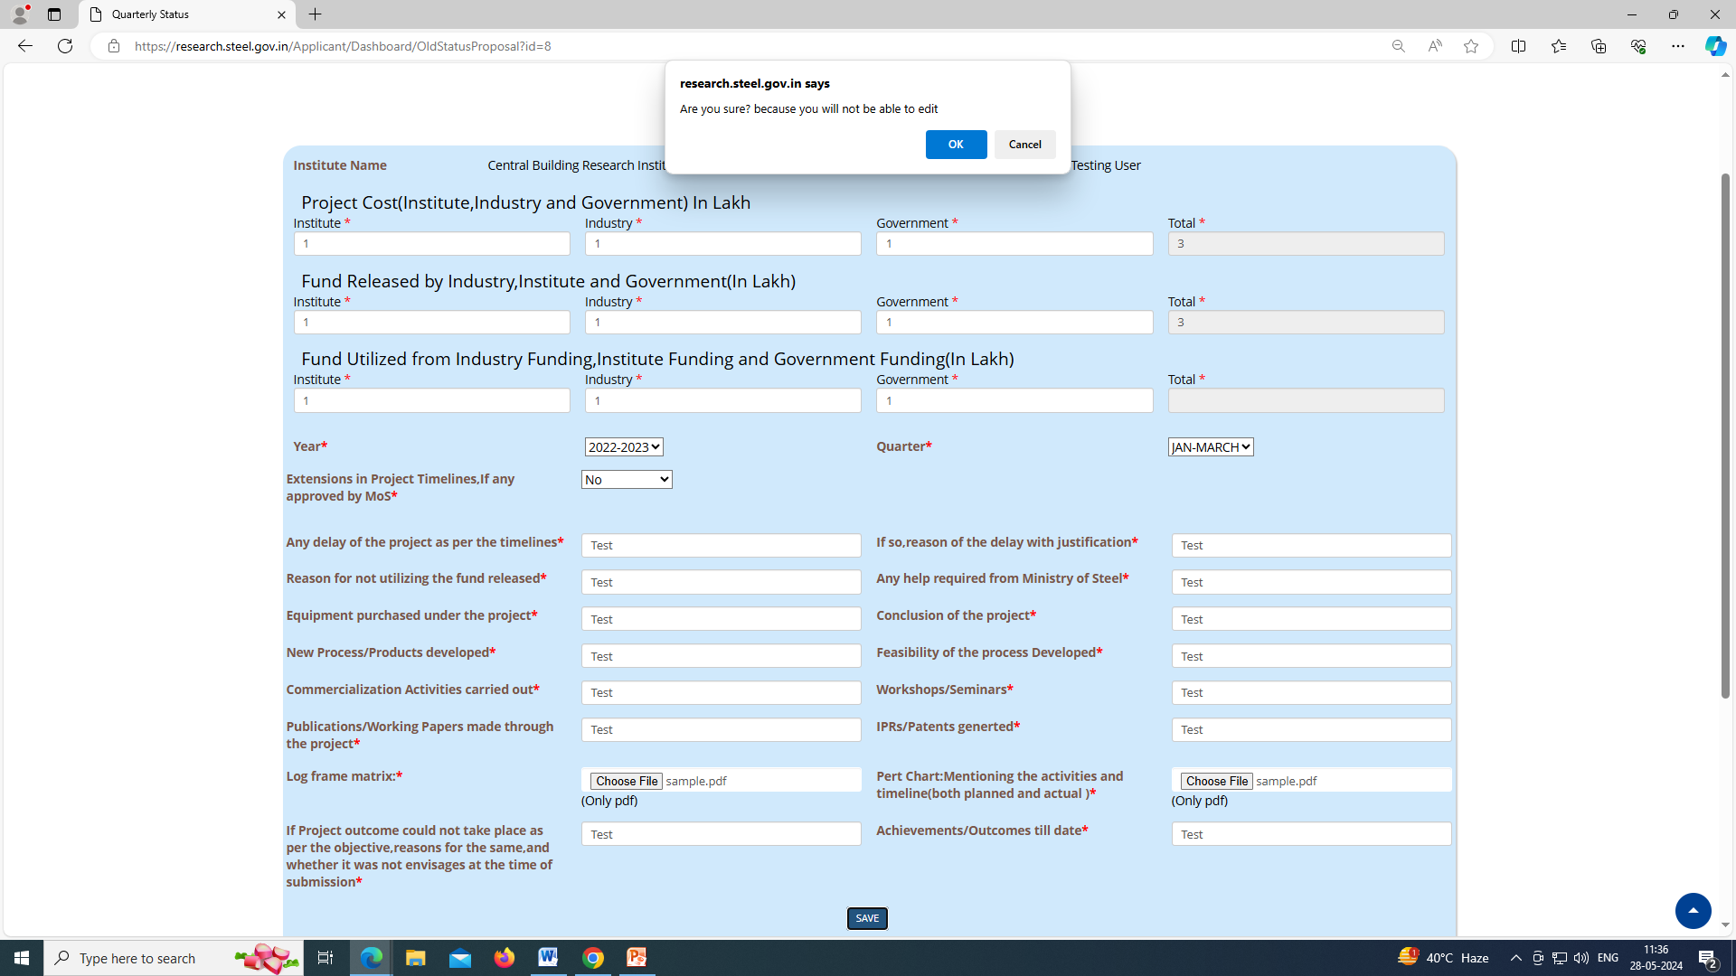
As user click on ‘Save’ button, message will be displayed (as shown in top).

Slide 26
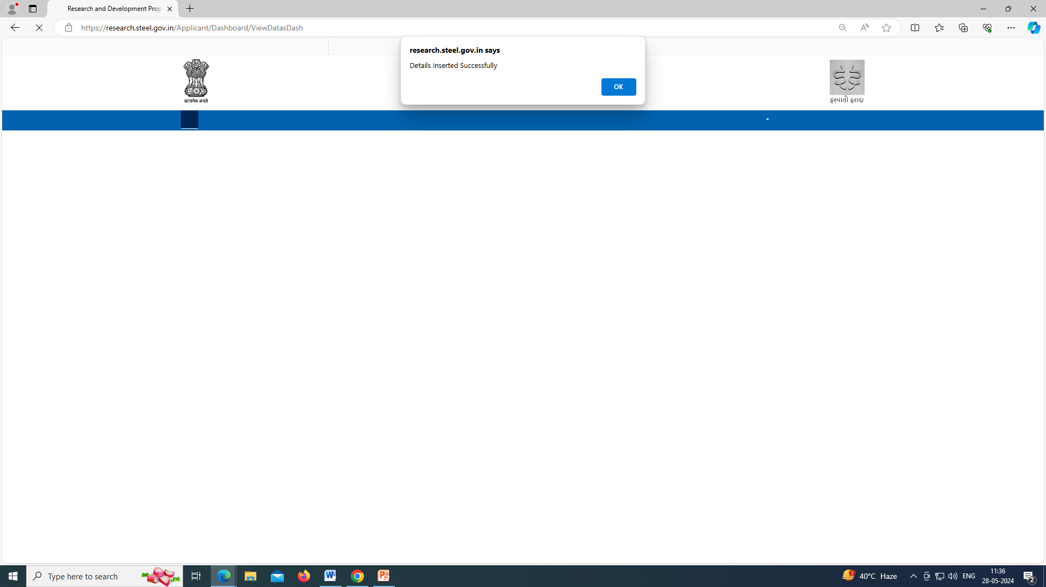
Refer previous slide, after ‘Ok’, User will get this message.

Slide 27
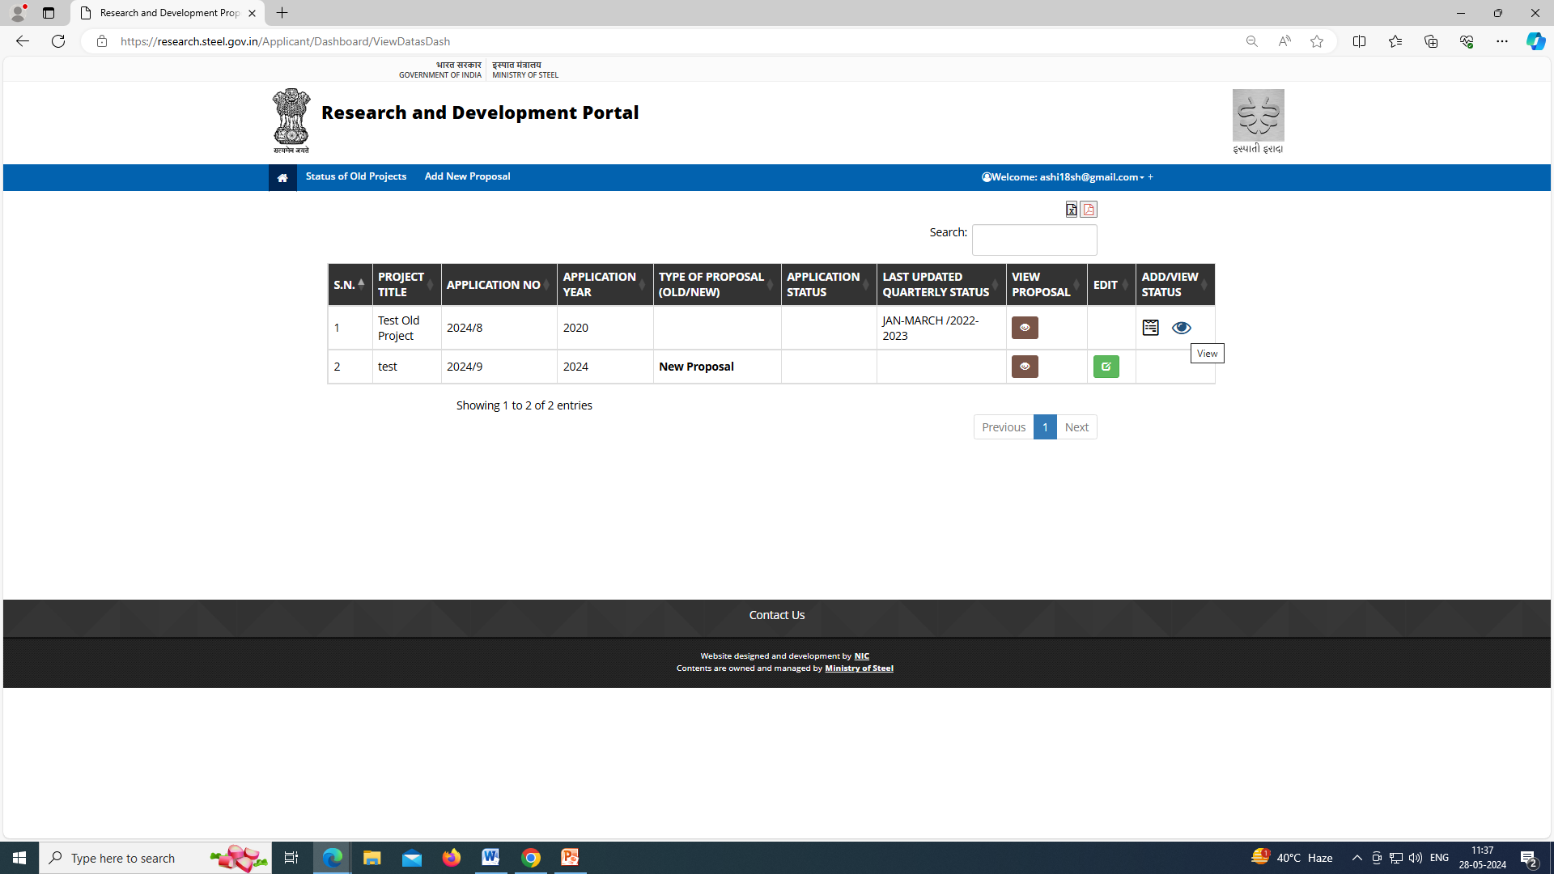
Once submitted, user can view after clicking on ‘View’ button.
Refer next two slides for complete pdf view.

Slide 28
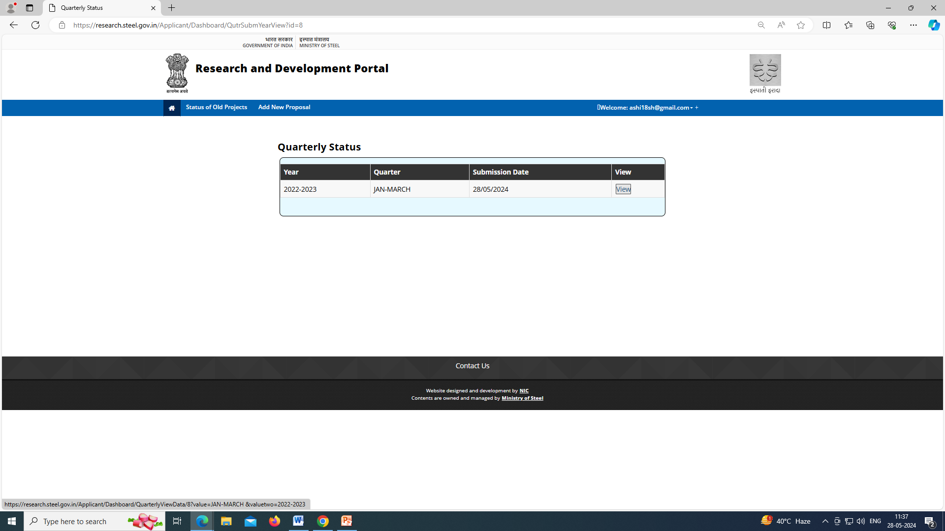

Slide 29
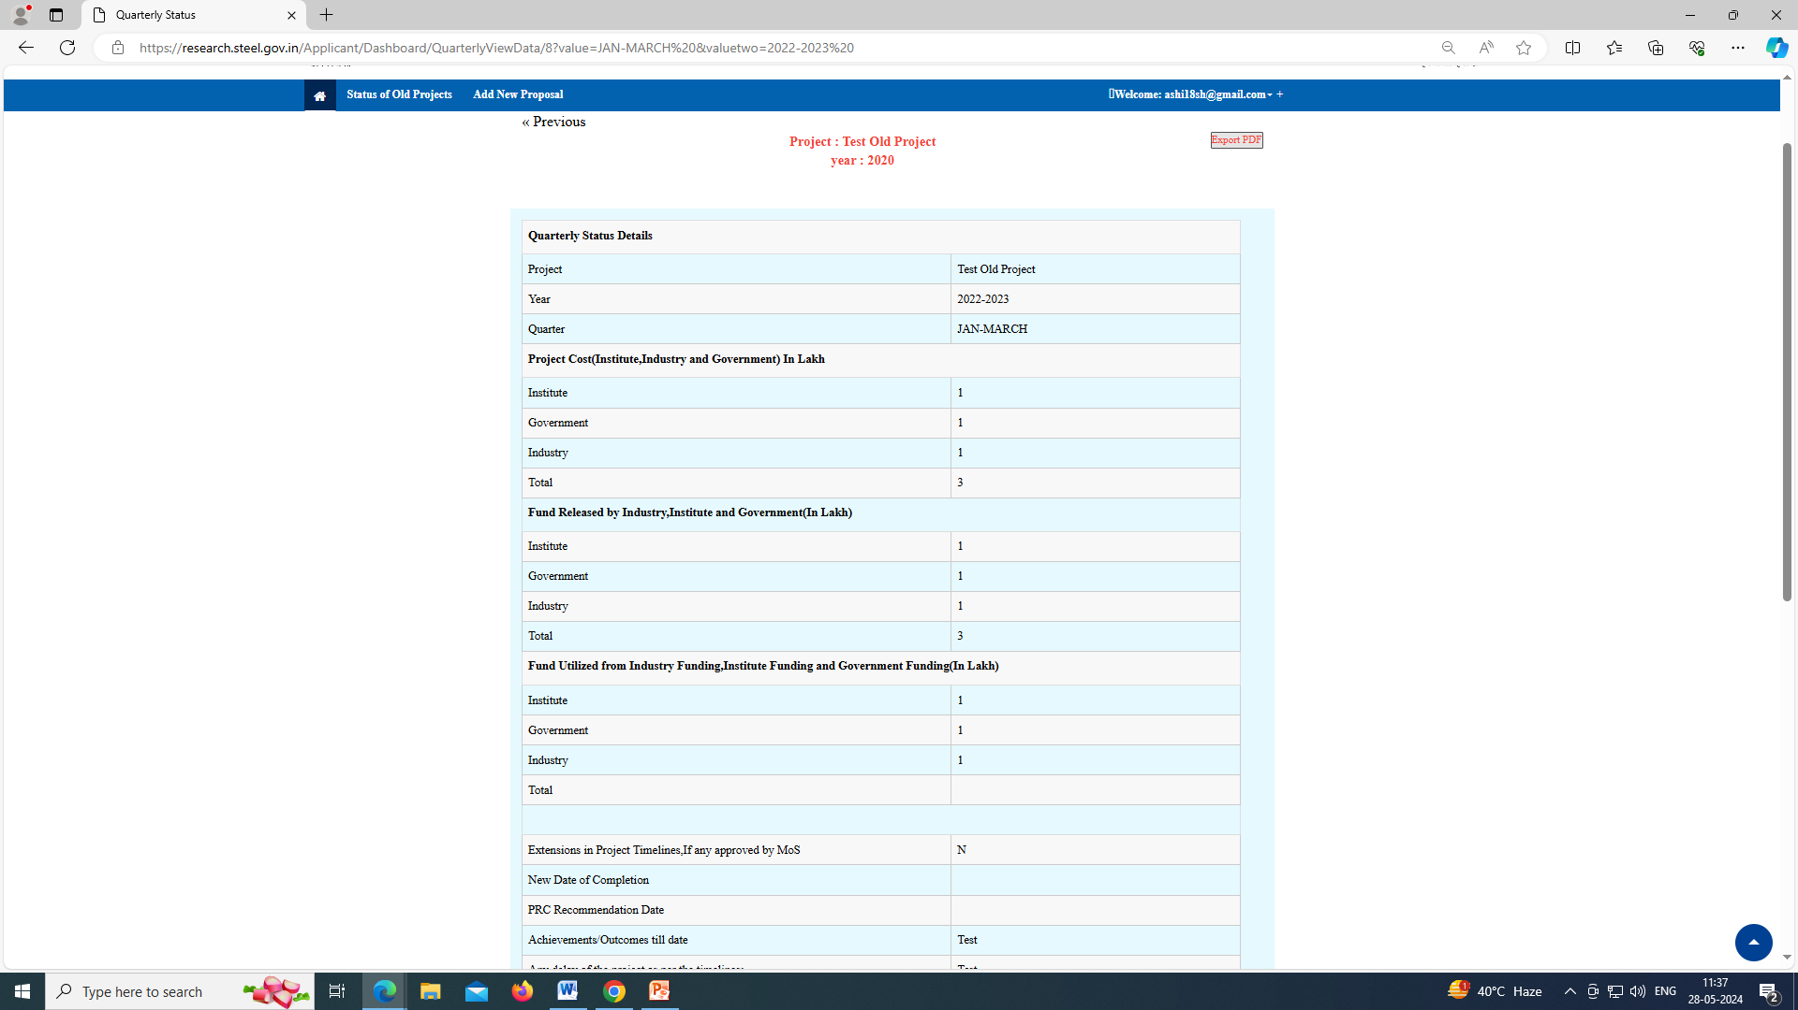

Slide 30
THANKING YOU…

